Slide 1
The A-Z of Geo Skills
Part 1: A to M

Slide 2
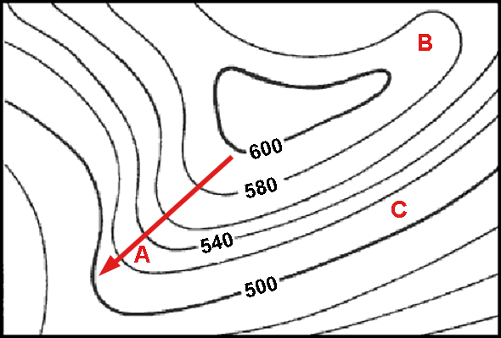
A
Aspect
• Aspect is simply the direction that a slope or object faces
• When looking at a map, the aspect of a slope can be determined by examining the height and pattern of the contour lines around it
• The direction from the highest point to the lowest point – in other words DOWNHILL – is said to be the direction the slope faces
•TIP: The contour lines often ‘point’ you to the correct answer. You also need to know the sun rises in the E and sets in the W – popular Exam Q
The A-Z of Geo Skills
Exam style questions:
What is the aspect of point A?
What is the aspect of point B?
What is the aspect of point C?
What is the contour interval?

Slide 3
A
Aspect
• Aspect is simply the direction that a slope or object faces
• When looking at a map, the aspect of a slope can be determined by examining the height and pattern of the contour lines around it
• The direction from the highest point to the lowest point – in other words DOWNHILL – is said to be the direction the slope faces
•TIP: The contour lines often ‘point’ you to the correct answer. You also need to know the sun rises in the E and sets in the W – popular Exam Q
The A-Z of Geo Skills
ANSWERS:
What is the aspect of point A? SW
What is the aspect of point B? NE
What is the aspect of point C? SE
What is the contour interval? 20 m

Slide 4
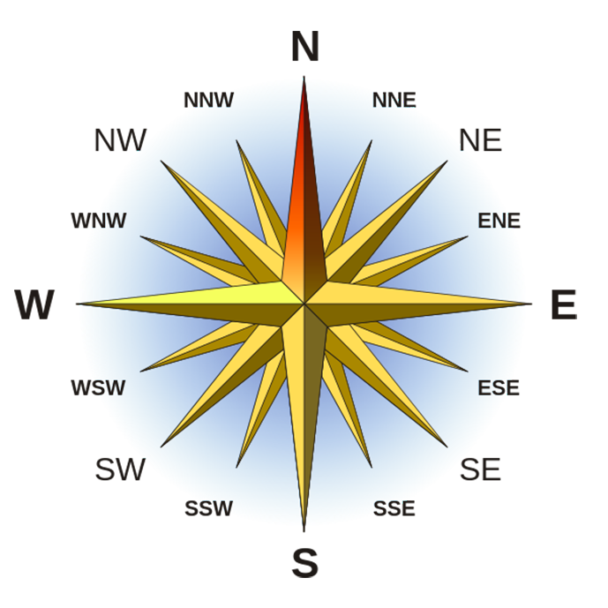
D
Direction
• Direction is important because it shows where one place is in relation to another
• North, South, East & West are known as the cardinal points of a compass while the others are known as intermediate points
• Maps usually have an arrow which indicates North
• TIPS: Never Eat Soggy WeetBix will help you remember the 4 cardinal points; you need to learn NE, SE, SW & NW; if you forget the others then always go to the cardinal point first ~ eg. the direction between N & NW is NNW
The A-Z of Geo Skills

Slide 5
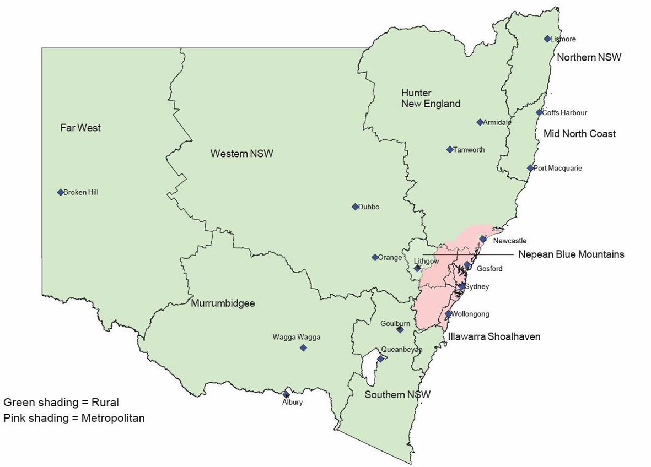
D
Direction
Exam style questions:
Q1) What direction is Dubbo from Tamworth?
Q2) What direction is Broken Hill from Albury?
Q3) What direction is Newcastle from Lismore?
Q4) Which region borders Northern NSW to
the south?
Q5) What 2 regions border the Far West region
to the East?
Q6) In what direction is Port Macquarie from
Sydney? A) N
B) NE
C) NNE
D) ENE
The A-Z of Geo Skills

Slide 6
D
Direction
ANSWERS:
Q1) What direction is Dubbo from Tamworth?
SW
Q2) What direction is Broken Hill from Albury?
NW
Q3) What direction is Newcastle from Lismore?
SSW
Q4) Which region borders Northern NSW to
the south?
Mid North Coast
Q5) What 2 regions border the Far West region
to the East?
Murrumbidgee and Western NSW
Q6) In what direction is Port Macquarie from
Sydney? A) N
B) NE
C) NNE
D) ENE
The A-Z of Geo Skills

Slide 7
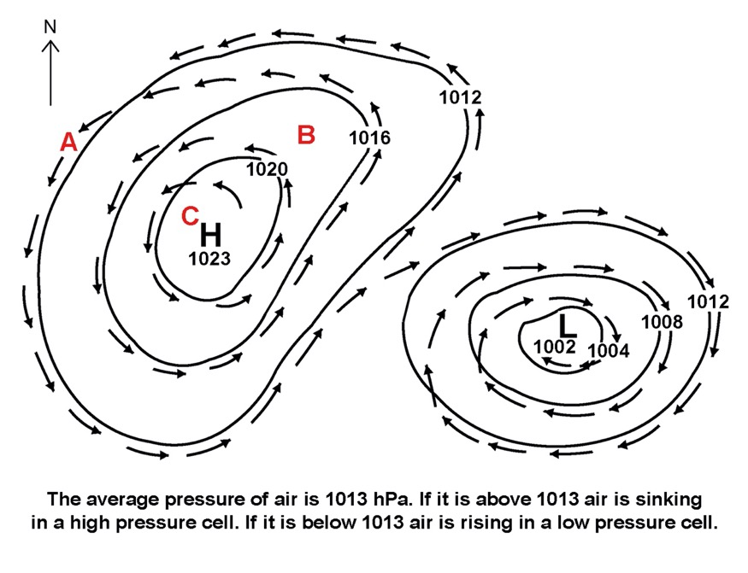
H
High Pressure Cells
• aka High pressure systems (or anti- cyclones), these are areas of stable atmospheric pressure
• When high pressure systems are about we generally have settled conditions, gentle winds, clear skies
• Air pressure increases towards the centre of a High pressure system
• Air flows out from the High in an anti-clockwise direction (HANTI) in the southern hemisphere
• During summer, southern Australia is dominated by Highs and northern
Australia by Lows
• TIP: Use the acronym HANTI to remember air flow
The A-Z of Geo Skills
Exam Style Questions:
Q1) Calculate the wind direction at Point A.
Q2) What is the air pressure at Point B?
Q3) What weather conditions could we expect at Point C?

Slide 8
H
High Pressure Cells
• aka High pressure systems (or anti- cyclones), these are areas of stable atmospheric pressure
• When high pressure systems are about we generally have settled conditions, gentle winds, clear skies
• Air pressure increases towards the centre of a High pressure system
• Air flows out from the High in an anti-clockwise direction (HANTI) in the southern hemisphere
• During summer, southern Australia is dominated by Highs and northern
Australia by Lows
• TIP: Use the acronym HANTI to remember air flow
The A-Z of Geo Skills
ANSWERS:
Q1) NE
Q2) Between 1016 and 1020 hPa
Q3) Stable, settled, sunny weather with light winds

Slide 9
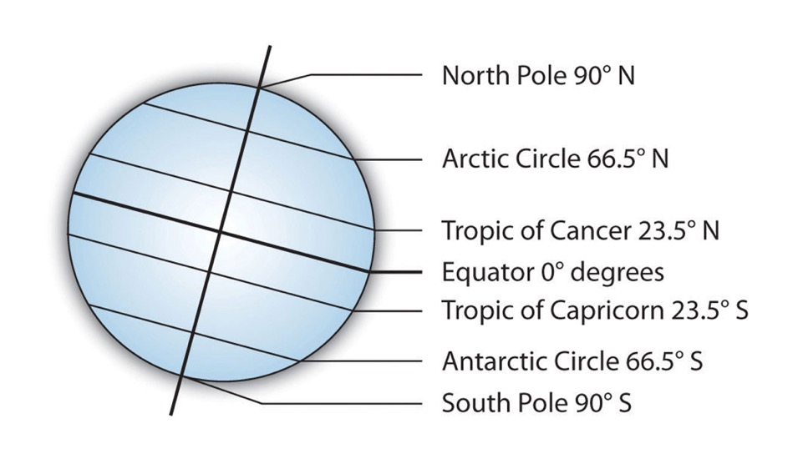
L
Latitude
• Lines of latitude are imaginary horizontal lines that run from east to west
• They are also called parallels of latitude as they are parallel to the Equator (which is 40,075 km in length)
• The maximum latitude is 90⁰
• The latitude of a place is crucial in determining climate
• Equatorial places are warmer because they are closer to the sun (the poles are furthest)
• There are 5 major lines of latitude (shown adjacent)
• TIP: LAT is FLAT!
The A-Z of Geo Skills
Exam Style Questions:
Q1) What is the maximum latitude?
Q2) Which Tropic runs through Australia?
Q3) True or False, all lines of latitude are the same size?

Slide 10
L
Latitude
• Lines of latitude are imaginary horizontal lines that run from east to west
• They are also called parallels of latitude as they are parallel to the Equator (which is 40,075 km in length)
• The maximum latitude is 90⁰
• The latitude of a place is crucial in determining climate
• Equatorial places are warmer because they are closer to the sun (the poles are furthest)
• There are 5 major lines of latitude (shown adjacent)
• TIP: LAT is FLAT!
The A-Z of Geo Skills
ANSWERS:
Q1) What is the maximum latitude?
90⁰
Q2) Which Tropic runs through Australia?
Tropic of Capricorn
Q3) True or False, all lines of latitude are the same size?
False, they get smaller as you approach the poles

Slide 11
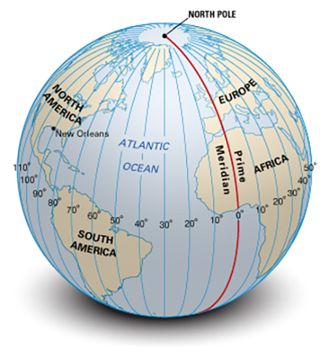
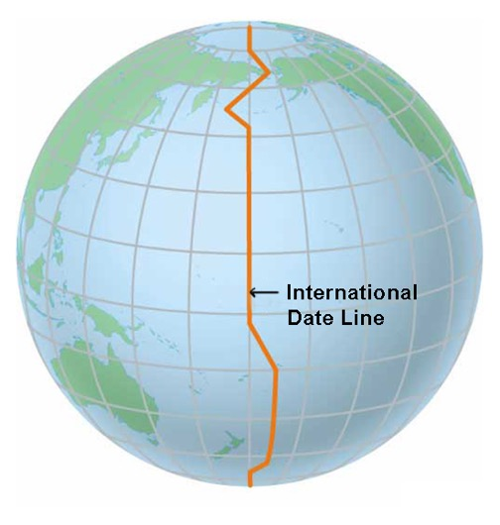
L
Longitude
• Lines of longitude are imaginary vertical lines that run from north to south
• They are also called meridians
• They are measured east or west of the Prime Meridian aka the Greenwich Meridian after the London suburb through which it runs
• They are farthest apart at the Equator and meet at the poles
• The max longitude is 180⁰
• There are 2 major lines of longitude (shown adjacent)
• TIP: LONG IS LONG!
The A-Z of Geo Skills
Exam Style Questions:
Q1) What is the maximum longitude?
Q2) Would New Orleans and New York be E or W of Greenwich?
Q3) Why is the International Date Line crooked in parts?

Slide 12
L
Longitude
• Lines of longitude are imaginary vertical lines that run from north to south
• They are also called meridians
• They are measured east or west of the Prime Meridian aka the Greenwich Meridian after the London suburb through which it runs
• They are farthest apart at the Equator and meet at the poles
• The max longitude is 180⁰
• There are 2 major lines of longitude (shown adjacent)
• TIP: LONG IS LONG!
The A-Z of Geo Skills
ANSWERS:
Q1) What is the maximum longitude?
180⁰
Q2) Would New Orleans and New York be E or W of Greenwich?
West
Q3) Why is the International Date Line crooked in parts?
So that countries don’t have towns/cities where there are separate days occurring a few metres apart!

Slide 13
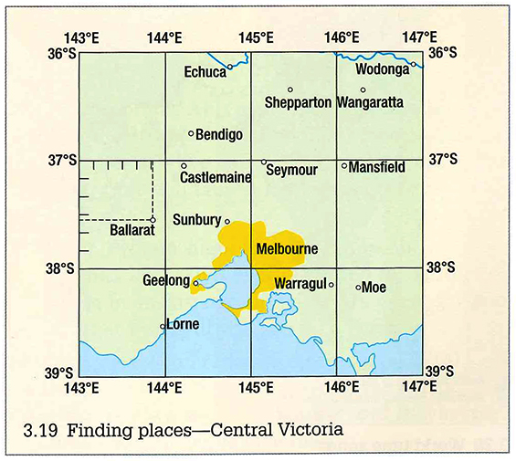
L
Latitude & Longitude
• the space between 2 lines of latitude or longitude can further be divided into 60 minutes – usually represented as ’ eg. Perth is 31⁰ 56’S.
• In other words, there are 60 minutes in each degree of latitude or longitude
• Latitude is ALWAYS written before longitude
• In the map adjacent, Ballarat’s location is 37⁰33’S, 143⁰51’E
• TIP: LAT is before LONG alphabetically
The A-Z of Geo Skills
Exam Style Questions:
Q1) Give the exact location of Moe using degrees and minutes.
Q2) Give the exact location of Bendigo using degrees and minutes.

Slide 14
L
Latitude & Longitude
• the space between 2 lines of latitude or longitude can further be divided into 60 minutes – usually represented as ’ eg. Perth is 31⁰ 56’S.
• In other words, there are 60 minutes in each degree of latitude or longitude
• Latitude is ALWAYS written before longitude
• In the map adjacent, Ballarat’s location is 37⁰33’S, 143⁰51’E
• TIP: LAT is before LONG alphabetically
The A-Z of Geo Skills
ANSWERS:
Q1) Give the exact location of Moe using degrees and minutes.
38⁰10’S, 146⁰15’E
Q2) Give the exact location of Bendigo using degrees and minutes.
36⁰48’S, 144⁰17’E

Slide 15
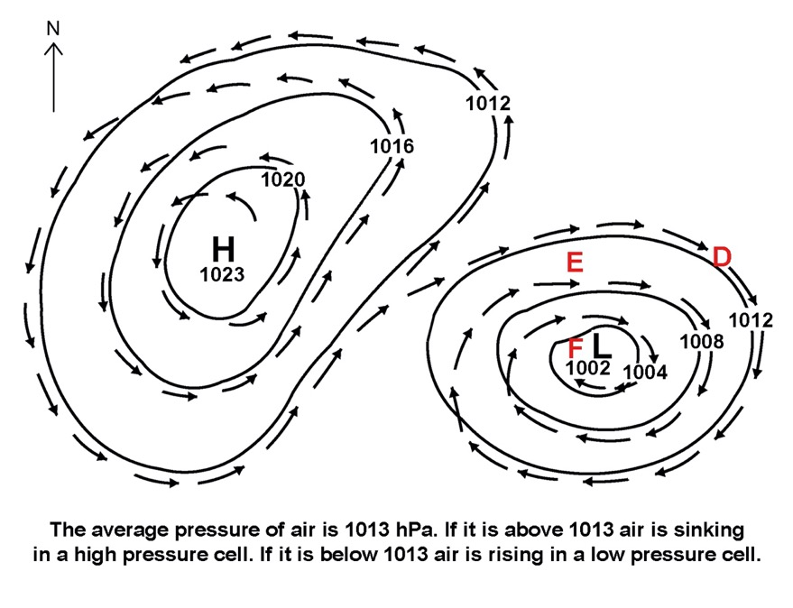
L
Low Pressure Cells
• aka Low pressure systems (or cyclones) form when warm air rises
• When low pressure systems are about we generally have unsettled conditions, strong winds, cloudy skies and a high chance of rain
• Air pressure decreases towards the centre of a Low pressure system
• Air flows in a clockwise direction (LOWCL) towards the centre of a
Low in the southern hemisphere
• An intense low will result in a Tropical Cyclone (T.C.)
• TIP: Use the acronym LOWCL to remember air flow
The A-Z of Geo Skills
Exam Style Questions:
Q1) Calculate the wind direction at Point D.
Q2) What is the air pressure at Point E?
Q3) What weather conditions could we expect at Point F?

Slide 16
L
Low Pressure Cells
• aka Low pressure systems (or cyclones) form when warm air rises
• When low pressure systems are about we generally have unsettled conditions, strong winds, cloudy skies and a high chance of rain
• Air pressure decreases towards the centre of a Low pressure system
• Air flows in a clockwise direction (LOWCL) towards the centre of a
Low in the southern hemisphere
• An intense low will result in a Tropical Cyclone (T.C.)
• TIP: Use the acronym LOWCL to remember air flow
The A-Z of Geo Skills
ANSWERS:
Q1) NW
Q2) Between 1008 and 1012 hPa
Q3) Unsettled, cloudy, rainy weather with strong winds

Slide 17
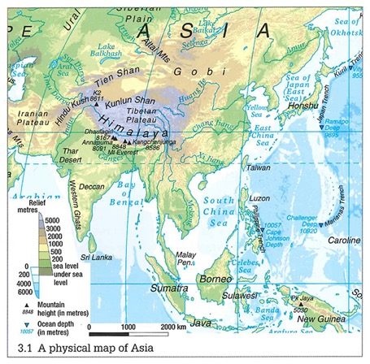
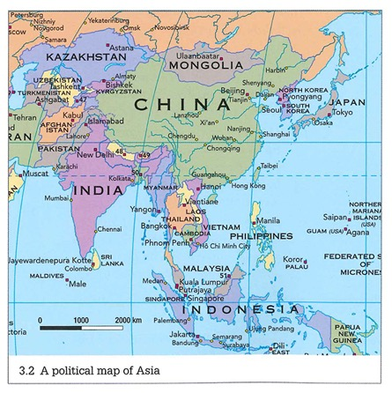
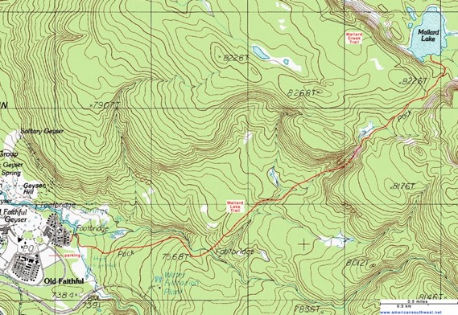
M
Map types (1)
• Physical maps show natural features such as rivers, mountains, lakes and deserts
• Political maps show political units such as countries or states. They also show cities and towns and often mark capitals with a red star or dot
• Topographic maps are detailed maps showing features of the natural environment and the built environment
• TIP: Physical maps tend to use colours occurring naturally in the environment
1
2
The A-Z of Geo Skills
3
1) Physical map, 2) Political map, 3) Topographic map

Slide 18
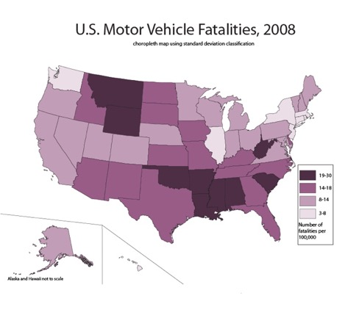
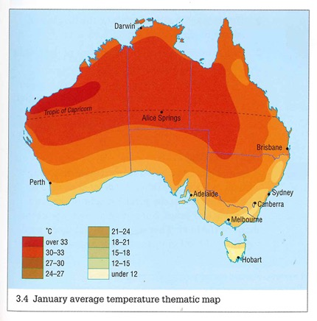
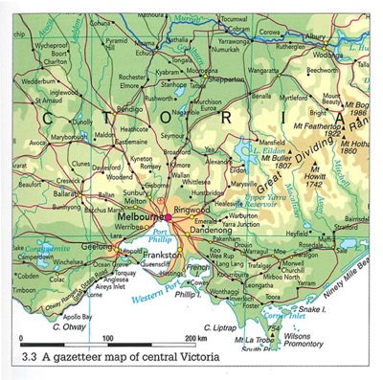
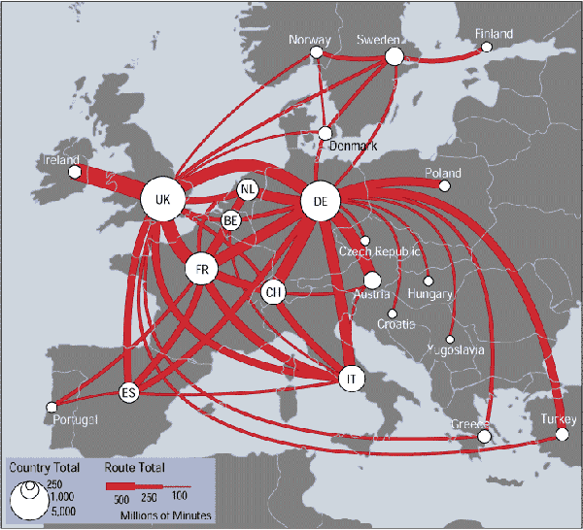
M
Map types (2)
• Choropleth maps use different colour shades to show amounts or values of something. Darker shades show high concentrations and light shades low
• Thematic maps illustrate specific themes such as forest cover, land use or population density
• Gazeteer maps (or reference maps) show both physical and political features such as railways, roads, cities and places
• Flowline maps are used to show the flows and movements between places and countries using arrows and lines
1
2
The A-Z of Geo Skills
3
4
Choropleth map, 2) Thematic map,
3) Gazeteer map (Reference map), 4) Flowline map

